Slide 1
Day 3
Events, Async, Parallelism

Slide 2
But first
A bit of order in the solution
Notes:
Separate into projects: Entities, IO

Slide 3
Why events?
Need a way to notify other parts of the system when something happens
Decoupling: Publisher doesn't need to know who is listening
Common in UI, system hooks, file watching, logging, etc.
Notes:
Ask: Examples from our app?
When a task is completed, we want to log it, send a notification, and update the UI — without TaskItem knowing how

Slide 4
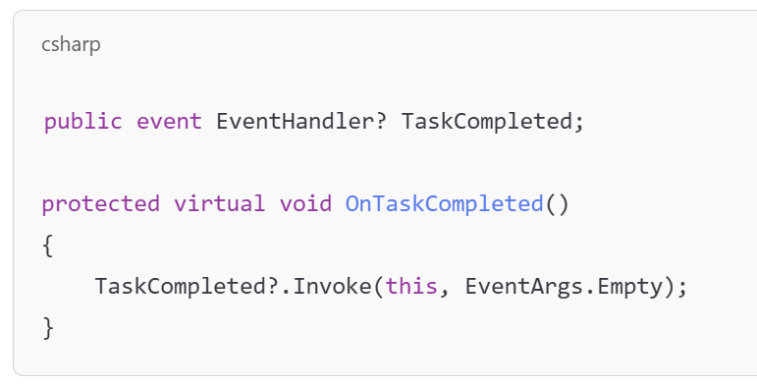
Basic Event Pattern
event keyword restricts how delegates are used
Follows EventHandler or EventHandler<T> signature
Convention: OnEventName() method to raise the event

Slide 5
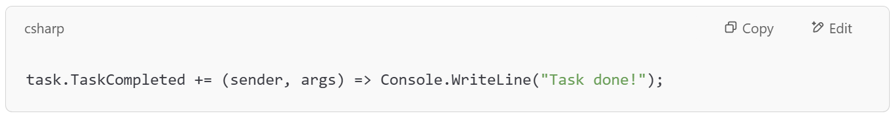
Subscribing to an Event
Anyone can subscribe using +=
Use anonymous methods or lambdas
Can unsubscribe with -=

Slide 6
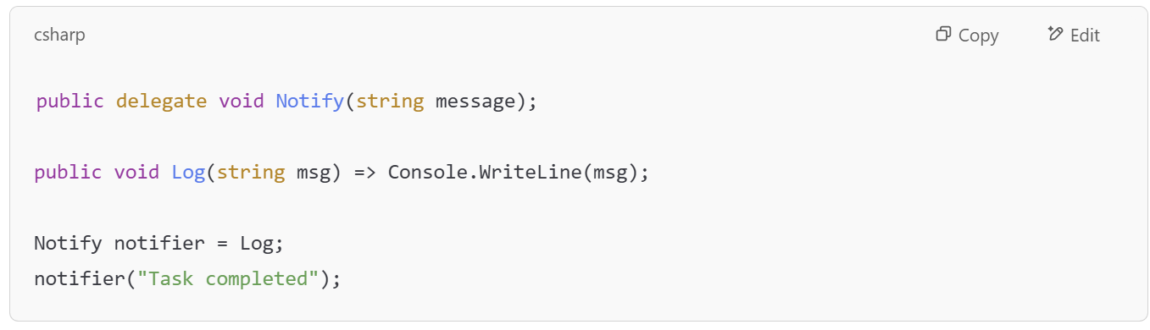
Delegates
A delegate is a type-safe reference to a method
Allows storing/calling functions dynamically
Needed to define custom events

Slide 7
OnTaskAdded
together

Slide 8
Add events
TaskDeleted, TaskUpdated, TaskListCleared
Register and Console.WriteLine them

Slide 9
Extension Methods
A way to “extend” the functionality of an object
public static <return_value> FuncName(this <object_type> <object_name>){}
Can be called using: <object_type>.FuncName(…)
Will show “(extension)” when hovering over the function name
Only use for small extensions and tools

Slide 10
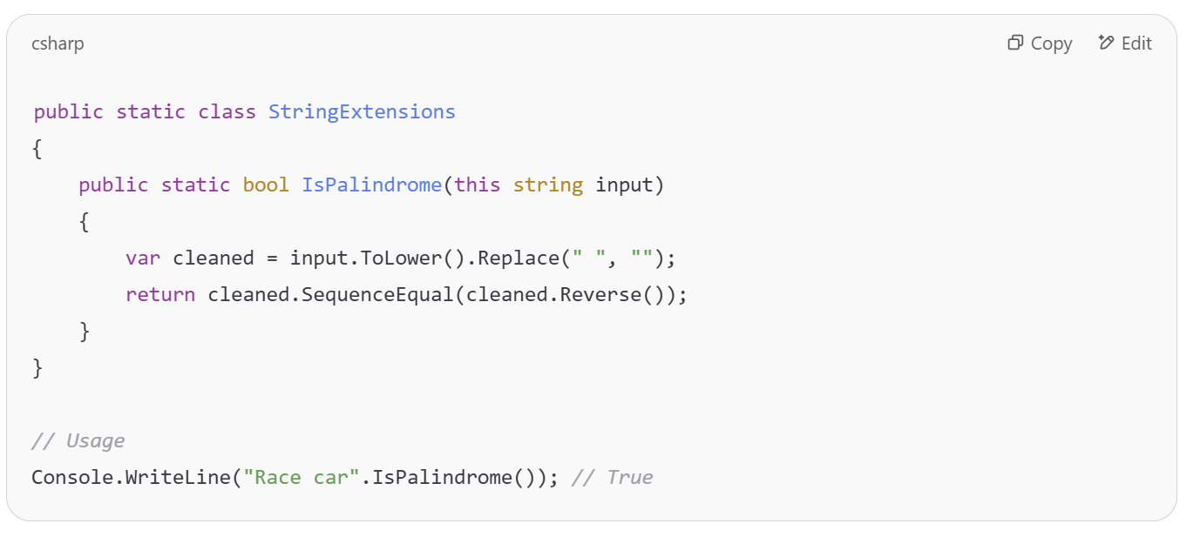
Extension Methods

Slide 11

Async/Await

Slide 12
What is async/await?
async makes a method asynchronous.
await tells the method to pause execution until the awaited task completes.
Asynchronous != multithreading. It's about non-blocking, not spinning up new threads (though it might happen).

Slide 13
Async vs Multithreading
Async/await lets you pause a method while waiting for something external (like file read or HTTP request), without blocking a thread.
Multithreading spins up new threads so multiple operations can run in parallel, useful for heavy CPU work.

Slide 14
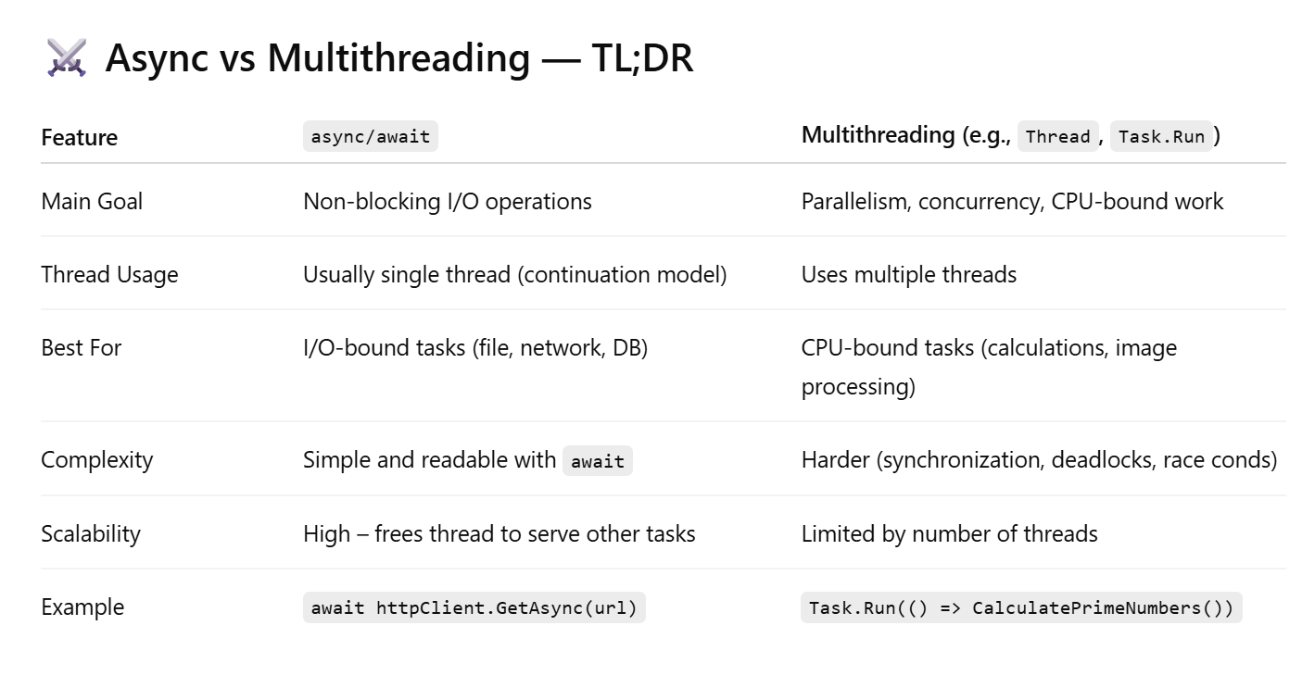
Async vs Multithreading

Slide 15
Common Gotchas
Forgetting await: SaveTasksAsync(); ← doesn't wait!
Blocking async code: Task.Result or task.Wait() = 💥 deadlocks.
No exception handling: use try/catch around await.

Slide 16
Summary
Use async for I/O, use threads for number crunching

Slide 17
Exercise
Add Console Logs for when a task is added
Use async to read/write data from file system
Use Cancellation Token

